Slide 1
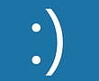
Your PC hasn’t looked at Error Handling Yet, so this Lesson will Look to Teaching You How to Handle and Resolve Errors in Programming
You can search for this status code if you’d like: MRBU04C25

Slide 2
Learning Intentions
demonstrate understanding of and use the following:
data validation, including presence, length, type and format checks;
detection and correction techniques for syntax, execution and logic errors;
simple error trapping techniques;

Slide 3


What is Data Validation?
Checking or ensuring input data entered against a set of criteria, rules, or conditions to ensure that it is reasonable, sensible, acceptable, or lies within specific boundaries, usually completed at the input stage.

Slide 4
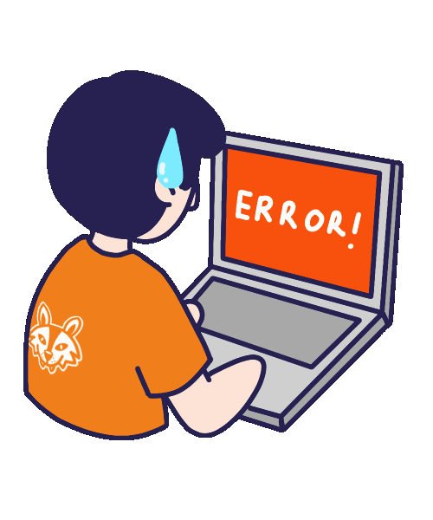
What Does The Error Handling Topic Involve?
demonstrate understanding of and use the following:
  data validation, including presence, length, type and format checks;
  detection and correction techniques for syntax, execution and logic errors;
  simple error trapping techniques;

Slide 5

Data Validation
Data validation is the automatic checking of data entered into a computer system.
Validation involves using the properties of the data to identify any inputs that are obviously wrong.
  Validation only proves that the data entered is a reasonable value for the computer to accept. It cannot prove that the data entered is the actual value the user intended.
In short, Data validation ensures data entered into a system is sensible, reasonable and within acceptable limits/boundaries. It does not ensure data entered is correct.

Slide 6
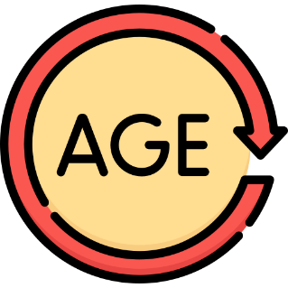

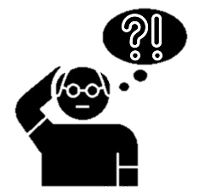
Why do we need validation?
If a user enters the value -5 when asked to enter their age, then this is an obvious error (age can’t be negative), and an automated check should be able to spot it.
Similarly, 33 April 2017 is clearly incorrect if a date was expected - again an automated check should be able to spot this. We refer to these as invalid values and computer systems should have validation checks that prevent invalid values being entered.
Validation checking cannot of course catch all errors. For example, a user may mistakenly enter the value 21 as their age, when they are actually 22. Errors of this kind cannot generally be caught by validation checks.

Slide 7

Data Validation Checks
Data validation can involve a number of checks:
  Presence Check – If a field is compulsory, a presence check should be used to ensure data is not left blank
  Length Check – Some text values should be entered with a certain number of characters
  Type Check – Data entered should be of a specific data type, such as int or string.
  Format Check – This check is used to ensure data entered is in a predefined pattern or format
  Range Check – This check is used to ensure data entered is within an upper and lower boundary or limit.

Slide 8
Write TRUE or FALSE beside each of the following statements about validation.
Statement | TRUE/FALSE
Validation will ensure that the program never crashes.
Validation cannot tell if the data is correct.
During validation, the data entered is checked to ensure it is sensible and reasonable
Validation is carried out when data is output.
[4]
Notes:
FALSE
TRUE
TRUE
FALSE

Slide 9
Write TRUE or FALSE beside each of the following statements about validation.
Statement | TRUE/FALSE
Validation will ensure that the program never crashes.
Validation cannot tell if the data is correct.
During validation, the data entered is checked to ensure it is sensible and reasonable
Validation is carried out when data is output.
FALSE
TRUE
TRUE
FALSE
[4]
Notes:
FALSE
TRUE
TRUE
FALSE

Slide 10

Detection And Correction Techniques
There are three types of errors that can occur when programming:
  Syntax Errors
    Will not compile
    Usually caused by error in the spelling or omission of a symbol
  Execution Errors
    Also known as a run-time error
    Code will compile, but will crash sometime during its execution
    Usually trying to read or write to a file that doesn’t exist or use an array index that is outside of an array’s length or trying to divide by 0.
  Logic Errors
    Occurs during execution
    Gives unexpected result or output but works and does not cause crashes.
    The output produced by the program does not match the expected output.
    Usually detected during testing.

Slide 11

Syntax Errors
Logic Errors
Syntax errors occur either when the program statements cannot be understood because they do not follow the rules laid down by the programming language, statement syntax errors, or when program structures are incorrectly formed, program syntax errors or structure errors.
Logical errors are mistakes in the design of a program, such as the use of an inappropriate mathematical formula or control structure, recognised by incorrect results or unexpected displays.
Execution Errors
Execution errors or run-time errors are errors that are detected during program execution. These errors, such as overflow and division by zero, can occur if a mistake is made in the processing algorithm or because of external effects not catered for by the program, such as lack of memory or unusual data.

Slide 12

Debugging
Debugging is the process of detecting and correcting or removing errors from the code.

Slide 13
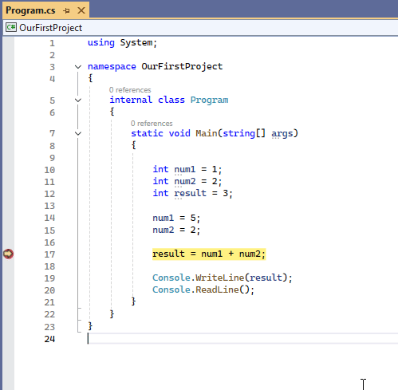
Simple Error-trapping Techniques
When errors occur in a program, the programmer must debug the code. This may mean going through each line of code and determining where the error has occurred, or creating a trace table to see how the expected output varies from the actual output at each line.
The programmer can set breakpoints in the code.
  A debug facility identifies errors and allows the programmer to step through each line of the program code and to inspect the values of variables.
  The program execution will stop at these breakpoints and the programmer will be able to view and edit variable values.

Slide 14
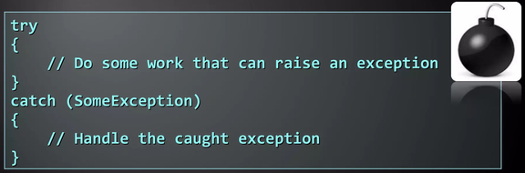
Exception Handling
It is the process where a program will attempt to deal with an error generated at run time so that the program does not crash.
When the error occurs, an exception is raised that ‘calls’ code to handle the error.
An unhandled exception will still cause the program to crash.
Programmers can make use of in-built exception-handling features and write customised code to handle specific errors.

Slide 15

Data validation is necessary to ensure that data entered is complete, falls within a set of boundaries specified and is sensible.
Data validation can be performed using presence, range, type, length and format checks.
Syntax errors occur when the program is being entered into the editor and are detected when the program is being compiled. A program with syntax errors will not compile.
Execution errors or run-time errors occur during program execution and will cause the program to crash. Division by zero will cause a run-time error.
Logic errors arise in programs that compile and run without error. However, the actual output produced by the program does not match the expected output.
Debugging is the process of removing errors from the code. It may involve using the debug feature of the IDE, creating breakpoints and stepping through code line by line.

